Slide 1

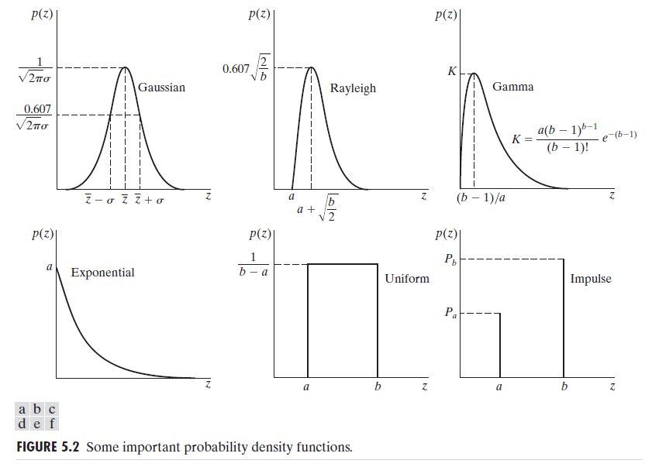
Digital Image Processing
32-Explain the different types of noise in terms of their probabilistic characteristics.

